Slide 1
Interface
Interface
is a special type of class-like structure
only contains constant declarations and method signatures (no method body sections)
Cannot be instantiated (ie no objects)
Can only be implemented by another class or extended by another interface
An interface contains only abstract methods.

Slide 2
More on Interface
An Interface has all abstract methods
Classes that inherit from an interface must provide all the effective methods
Therefore, all classes that inherit from an interface effect the same methods (have the same method signatures) but have no common code.
Classes which inherit from an interface use Interface Inheritance
Classes which inherit from an interface use the keyword implements instead of extends

Slide 3
Example: Shape
A shape has an area and a perimeter
Methods:
area()
perimeter()
There is no generic formula for the area or perimeter of a shape, so the methods should be abstract.
Since there are no other methods or attributes – shape should be an interface.
A circle, rectangle and triangle are all shapes

Slide 4
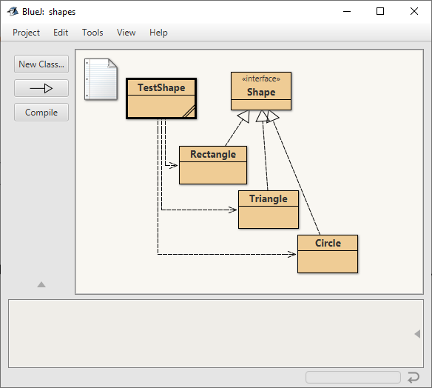
Shape Interface
public interface Shape
{
public double area();
public double perimeter();
}

Slide 5
Child Class Circle: Inherits from Shape
public class Circle implements Shape
Methods that MUST be implemented in Circle:
area()
perimeter()
Circle can have it’s own attributes e.g. radius
Circle can have it’s own methods e.g. diameter()

Slide 6
public class Circle implements Shape
{
public double PI = Math.PI;
protected double radius;
public Circle(double radius)
{
this.radius = radius; // no need to call super()
}
public double area() // implementation required
{
return PI * Math.pow(radius, 2);
}
public double perimeter() // implementation required
{
return 2 * PI * radius;
}
public double diameter() // unique child method
{
return 2 * radius;
}
}

Slide 7
Recap: Types Of Inheritance
Implementation Inheritance (keyword extends)
Interface Inheritance (keyword implements)
Inherits all methods & attributes from the parent class
class A extends B
There can only be one parent class
Inherits from an interface (skeleton – empty methods & constant attributes only)
class A implements InterfaceB
A class can inherit from many interfaces
Example: Class A extends B implements C, D

Slide 8
Multiple Inheritance
Multiple Inheritance – where a child class inherits from more than one parent class.
A child can implement multiple interfaces
Implementation Inheritance
Interface Inheritance
Parent class has coded methods, child class extends the code
Child class implements methods defined by the Interface

Slide 9
Interface Vs Abstract Class
Interface
Cannot be instantiated
Only contains abstract methods
Cannot contain changeable variables
Abstract Class
Cannot be instantiated
Can contain abstract methods
Can contain changeable variables
Uses Interface Inheritance
Uses Implementation Inheritance

